Slide 1
ELECTRICITY BILLING SYSTEM

Slide 2
PRESENTERS
B. KAVYA MANI GAYATHRI – 2010030234
B. SRAVANI - 2010030544

Slide 3
INDEX
INTRODUCTION
PROBLEM STATEMENT
LITERATURE SURVEY
GITHUB SETUP
WORK ALLOCATION
TOOLS REQUIRED
CONCLUSION

Slide 4
INTRODUCTION
This application is developed to manage the activity of Electricity Billing. Admin is the main user of the website who will manage every activity. This project is developed in Java and the database used here is MYSQL using MVC architecture. In the backend, we have used Servlet.
Electricity Billing System project in java is a web application where a user can pays bill online using this system. User can pay Electricity bill online so it will be easy for user. The complete process of Electricity Bill will be managed online. There is no need to maintain record manually.

Slide 5
PROBLEM STATEMENT
Ebilling System is developed to replace all the manual activity through an application. Through this application, the Admin who is the main user of the application will manage all the activities like add users, calculate Bill, and view Payment History etc. The main Objective of Ebilling System is to manage the activity of Billing System. The application will help to manage the users, calculate Bill, Pay Bill, View Payment, History and etc. This application can be used by the Electricity Board.
This project provides a simple and beautiful interface for the admin as well as to the Users. Just Admin needs to add Users and can Calculate Bill and view Payment History as well as can update cost of charge/unit.

Slide 6
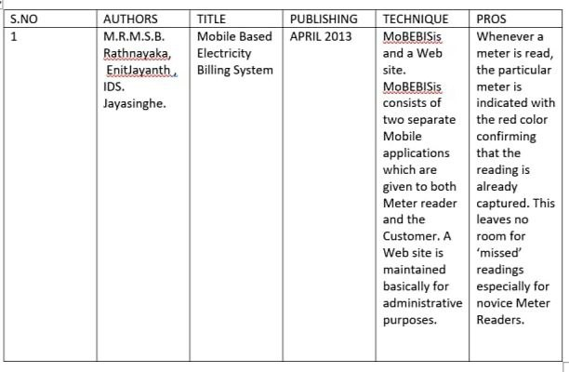
LITERATURE SURVEY

Slide 7
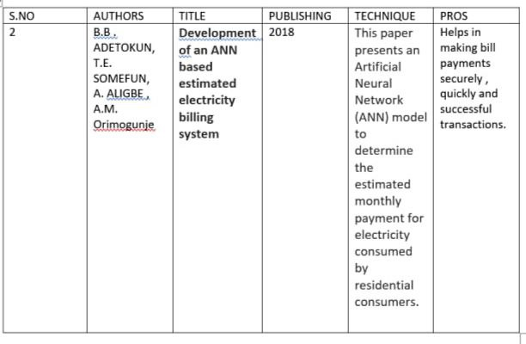

Slide 8
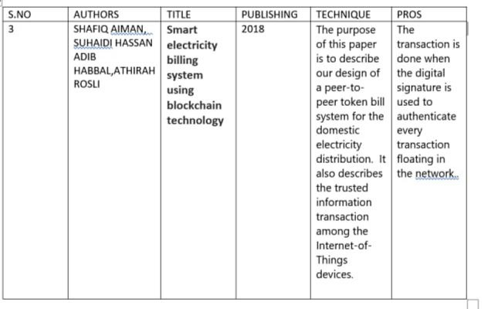

Slide 9
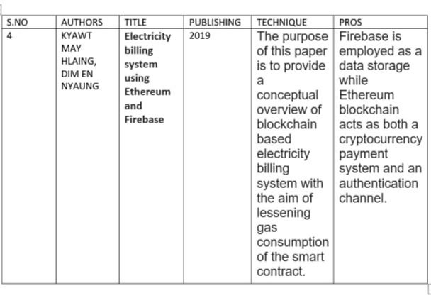

Slide 10
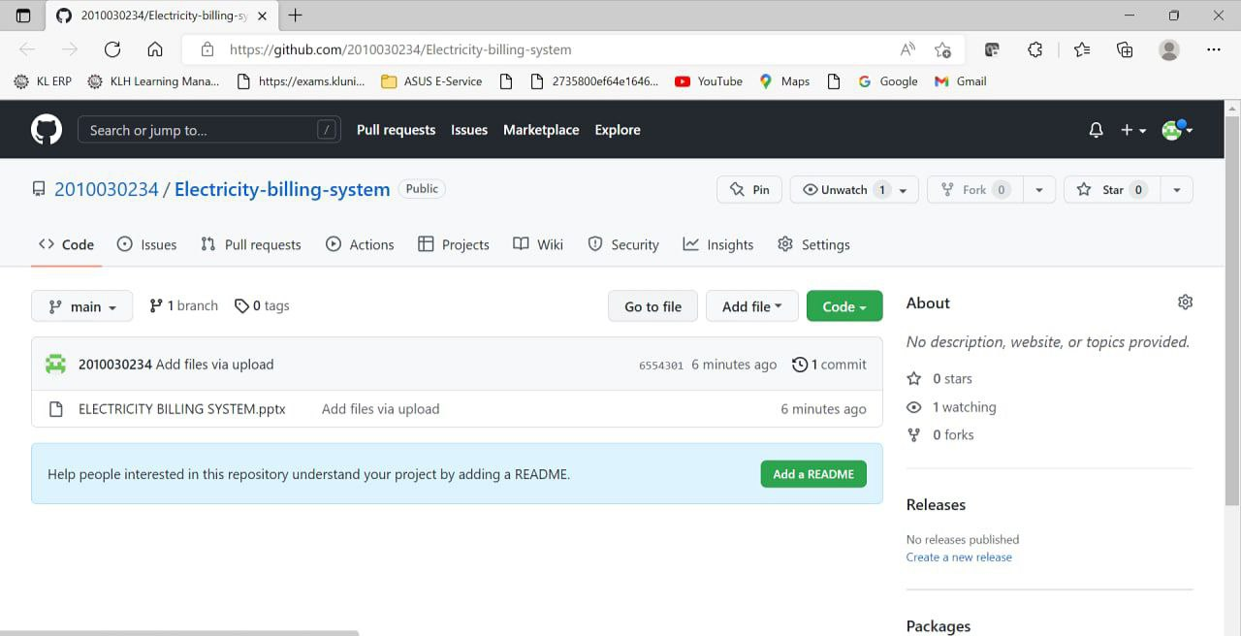
GITHUB COMMITS

Slide 11
WORK ALLOCATION
B, Kavya Mani Gayathri – 2010030234
Front-end , Servlet technology
B. SRAVANI - 2010030544
Backend , Login

Slide 12
TOOLS & TECHNIQUES REQUIRED
CLIENT/SERVER TECHNOLOGY : Servlet
SERVER : APACHE TOMCAT
ECLIPSE IDE
Front-End : JSP, HTML, CSS, JS, BOOTSTRAP
Back-End : MYSQL

Slide 13
CONCLUSION
IN CONCLUSION , THIS PROJECT IS AIMED AT DEVELOPING AN ONLINE SYSTEM THAT WILL ENABLE USERS OF ELECTRICITY PROVIDED BY THIS COMPANY TO CHECK THEIR ELECTRICITY BILLS AND MAKE THEIR PAYMENT ONLINE.

Slide 14


